Slide 1
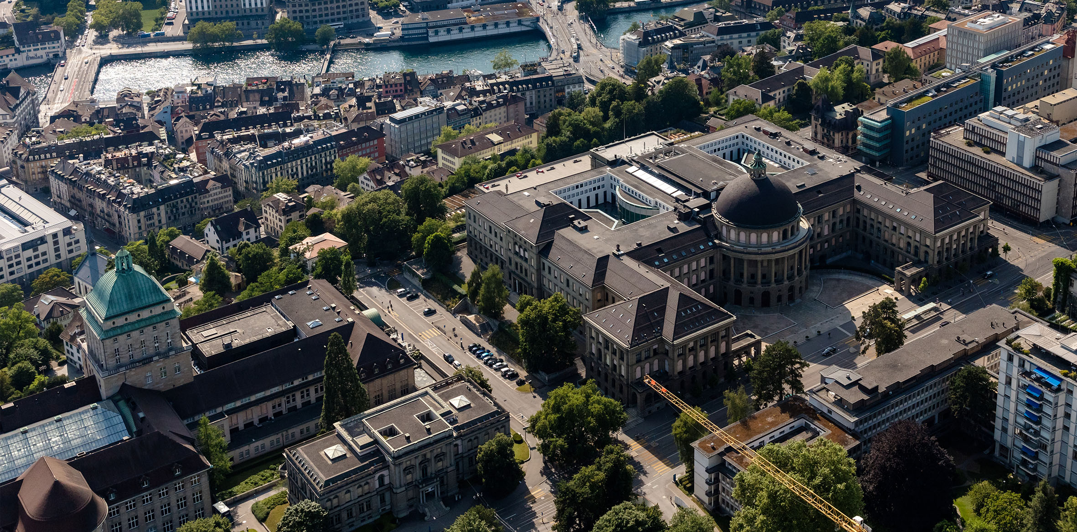
Image Pipeline for DHM
Fabian Braun
Master Thesis
07. September 2023, Zurich

Slide 2

For what are the images used?
Bacteria are observed during the growth process.
Directly measuring the mass of a bacteria is hard.
Literature assumption: length → volume → mass
Optical path difference → dry mass
Notes:
Label-free imaging: No contrast agant or dye needed -> living cells
Non-invasive: Does not damage or alter imaged samples -> suitable for long-term observations of living cells and tissues
High Sensitivity to Thickness -> sutable for studying cell morphology
Quantitative measurements: quatitative information about optical path length changes -> cell volume, dry mass, intracellular refractive index
High-throughput imaging: Can be adepted for high-throuput imaging systems, allowing for analysis of large sample populations and fast changing samples
Three-dimensional reconstruction: True 3 dimensional imaging by taking several images from all sides, pseudo-3d, by changing the focus distacne -> tracking
Multimodal imaging: Can be combined with other imaging modalities such as fluorescence microsopy or brightfield imaging- > comprehensive view of the sample‘s properties

Slide 3
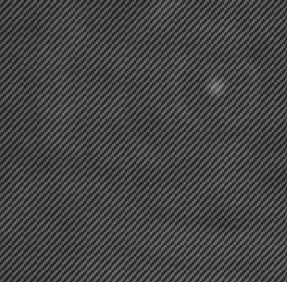
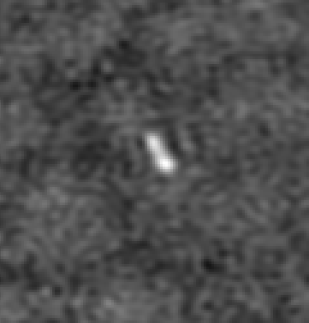
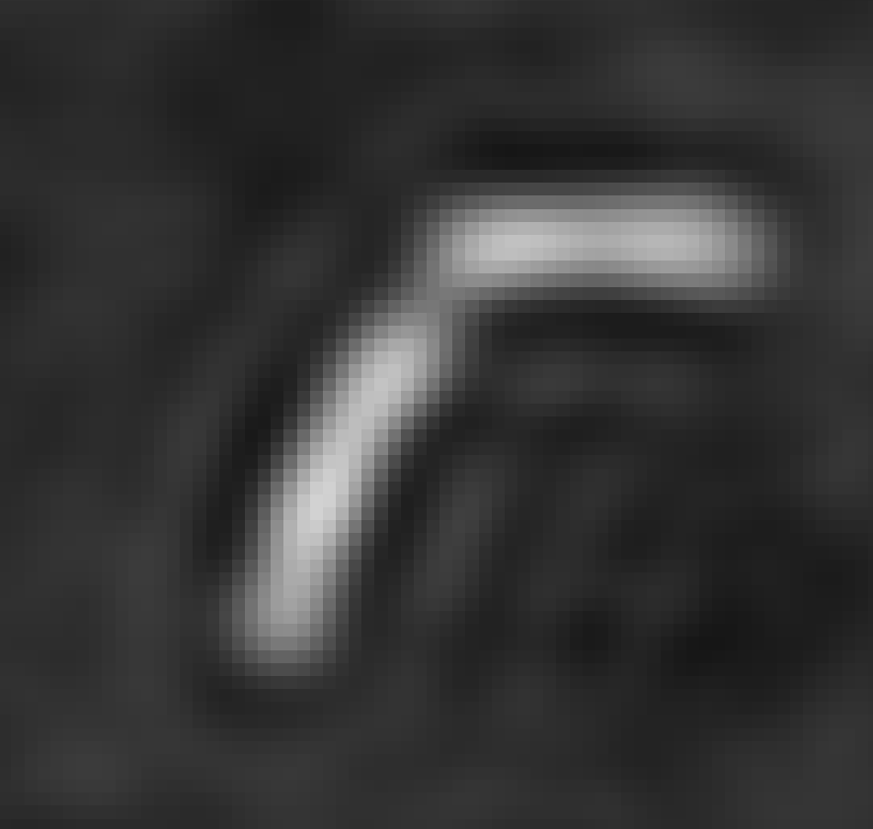
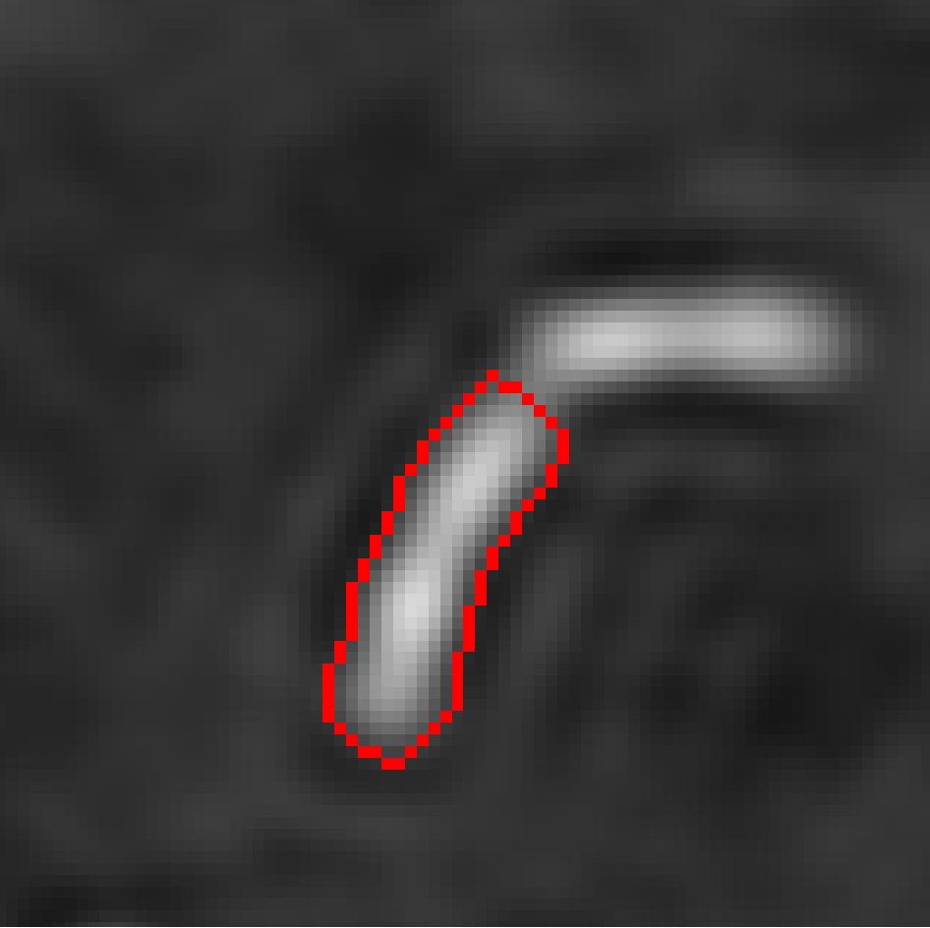
The pipeline consists of two parts
Phase image construction
Segmentation and linage tracking
Hologram
Phase image
Construction
Segmentation and tracking

Slide 4
Why are we interested in quantitative phase imaging (QPI)?
Digital holograpic Microsopy (DHM) is one of many QPI methods.
Cells and bacteria are often phase object, hardly visible by eye.
Advantages:
Label-free imaging
Non-invasive
High Sensitivity to thickness
Quantitative measurements
High-throughput imaging
Three-dimensional reconstruction
Multimodal imaging
Notes:
Label-free imaging: No contrast agant or dye needed -> living cells
Non-invasive: Does not damage or alter imaged samples -> suitable for long-term observations of living cells and tissues
High Sensitivity to Thickness -> sutable for studying cell morphology
Quantitative measurements: quatitative information about optical path length changes -> cell volume, dry mass, intracellular refractive index
High-throughput imaging: Can be adepted for high-throuput imaging systems, allowing for analysis of large sample populations and fast changing samples
Three-dimensional reconstruction: True 3 dimensional imaging by taking several images from all sides, pseudo-3d, by changing the focus distacne -> tracking
Multimodal imaging: Can be combined with other imaging modalities such as fluorescence microsopy or brightfield imaging- > comprehensive view of the sample‘s properties

Slide 5
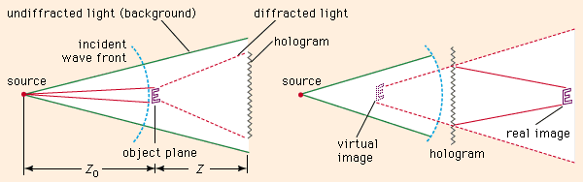
How does a holgram work?
In 1948 D. Gabor found principle that captures both amplitutde and phase information of an object using interference pattern.
Gabor's hologram is essentially the record of this interference pattern between an object beam and a reference beam on a photosensitive medium.
When the developed hologram is lit with the same light, the object beam reappears.
This object beam can be followed back; focus is achieved when the object distance matches the difference between object and hologram planes.
britannica.com/technology/holography

Slide 6
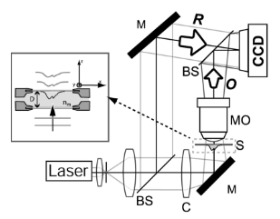
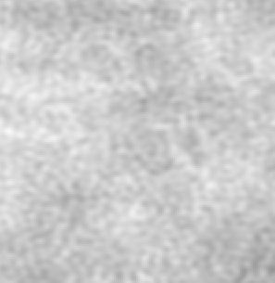
Digital holograpic Microsopy (DHM)
Reconstruction
Hologram
Refrernce beam and object beam are separated.
Beams are recombined with a slight angle. → Off-axis
Aquisition and reconstruction are digital.
Applications: Phase image, 3D tracking
Aquisition
Numerical reconstruction with Koala
Intensity image
Phase image

Slide 7
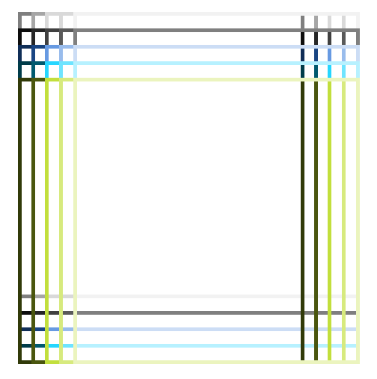
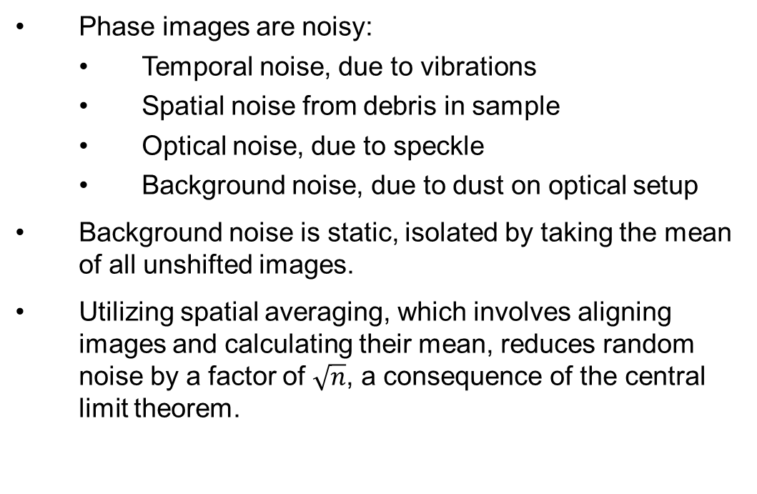
Previous workflow for processing phase images
Cell culture
Phase images are noisy:
Temporal noise, due to vibrations
Spatial noise from debris in sample
Optical noise, due to speckle
Background noise, due to dust on optical setup
Background noise is static, isolated by taking the mean of all unshifted images.
Utilizing spatial averaging, which involves aligning images and calculating their mean, reduces random noise by a factor of $\sqrt{n}$, a consequence of the central limit theorem.
Close up
shifts

Slide 8
Workflow Challenges and Resolutions
Problems:
Storage Demand: Storing holograms, phase, and intensity images takes up ~280 GB per experiment.
Uniform Focus Challenge: All images maintain a fixed focus distance. Most are only slightly out of focus, but a few show significant focus deviations.
Solution:
Reconstruction from Hologram: phase and intensity image can be reconstructed from the hologram on the fly with the help of Koala with various focus distances.
Focus Determination: To address focus inconsistencies, implement focus determination based on image characteristics and known phase object attributes:
Find focus distance based by image features and knowledge about phase objects:
In the intensity image, ensure that bacteria remain invisible.
In the phase image, guarantee that bacteria appear sharp.

Slide 9
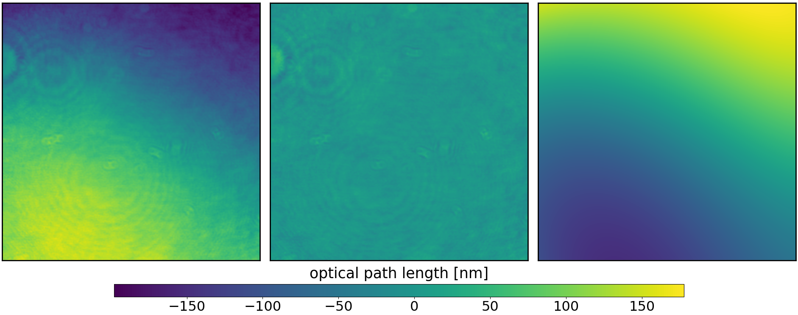
Process 1: Surface plane subtraction
Uneven surface: Caused by imperfect alignment of optical instruments in DHM.
Subtraction with Koala only possible during experiment and not in postprocessing
Surface: Adjusted using linear regression on a polynomial foundation.
Before
After
Difference

Slide 10
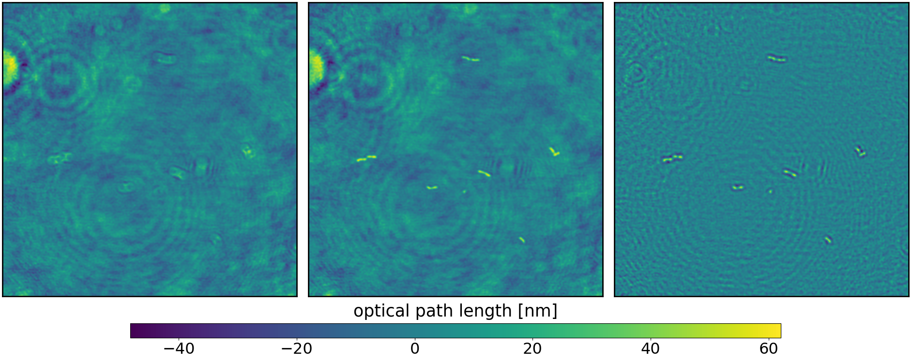
Process 2: Focusing
Deviation from set focus distance: Unknown reason and also unpredictable
Automatic focusing: Based on image features
Image depicted has a strong focus deviation.
Before
After
Difference

Slide 11
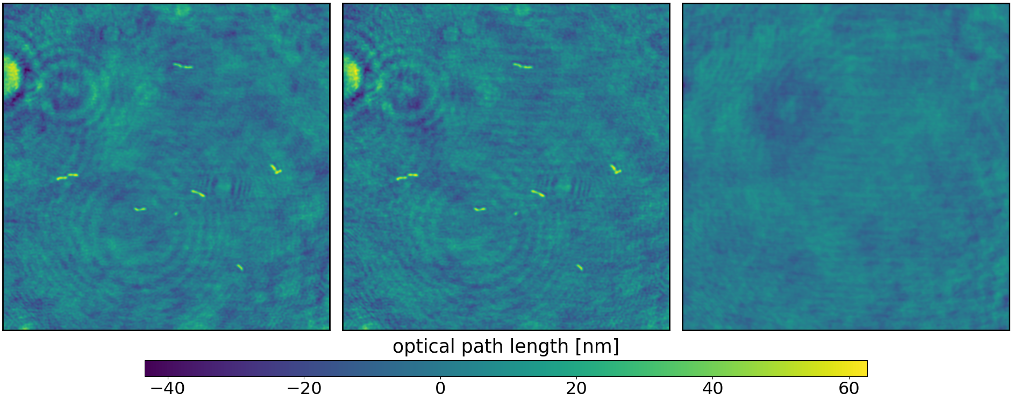
Process 3: Background subtraction
Static Noise: Dust or other disturbances on the optical system
Median of unshifted image stack
Calculated on the first ten timesteps as later images can get crowed
Before
After
Difference

Slide 12
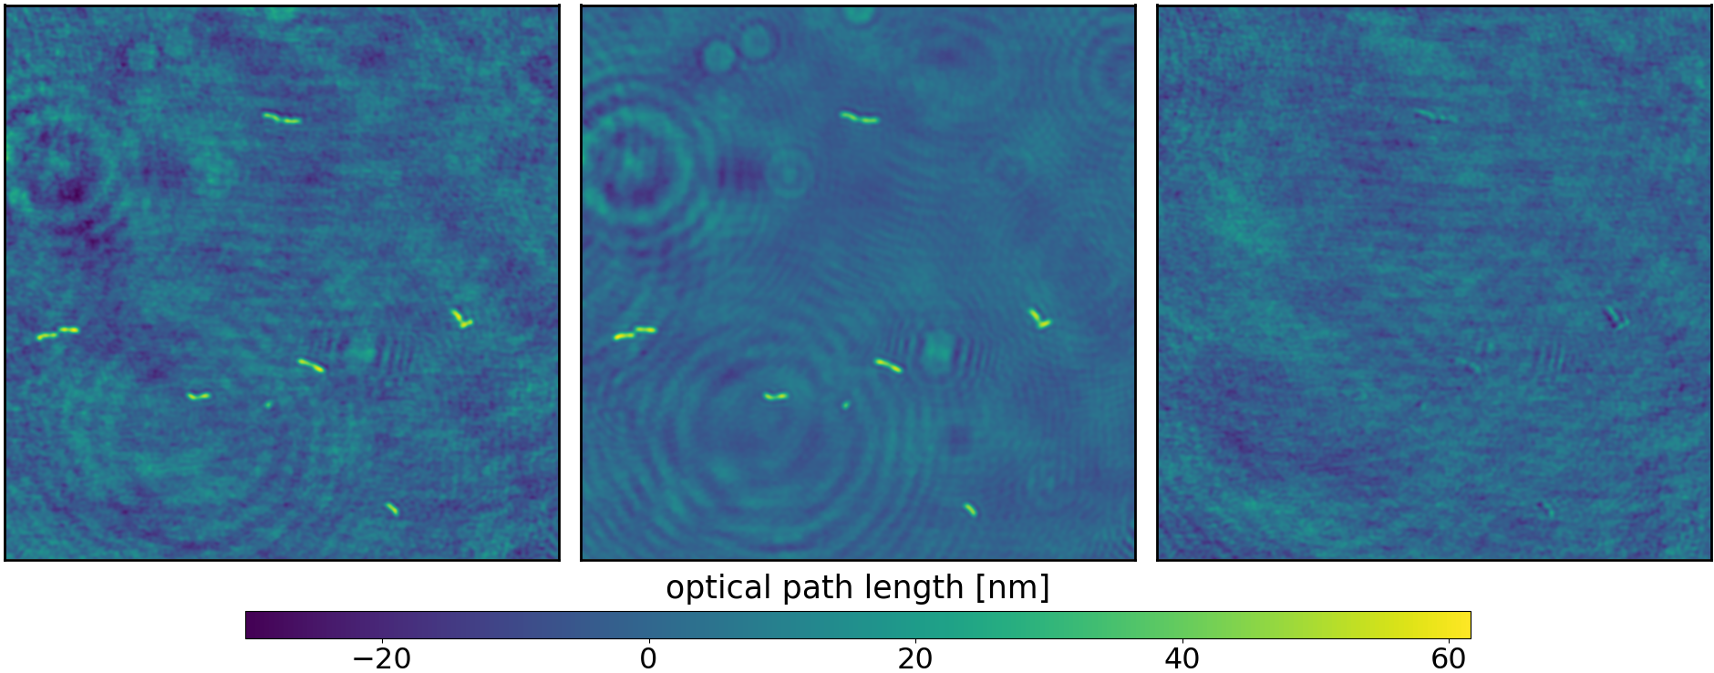
Process 4: Spatial averaging
Reduces random noise.
Calculates relative shifts between images using phase cross correlation.
Stacks shifted images, calculates the average, and then trims the outer portion.
Before
After
Difference

Slide 13
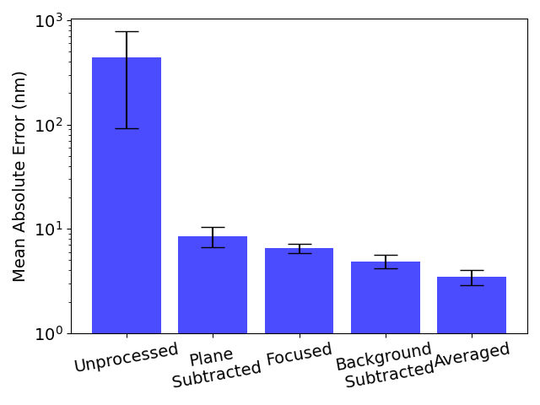
Results: pixel error
Data based on 1600 images from two experiments with different bacteria.
Mean signal of a bacteria is ~25 nm.
Focus improvements are in average low as only a few are out heavily out of focus.

Slide 14
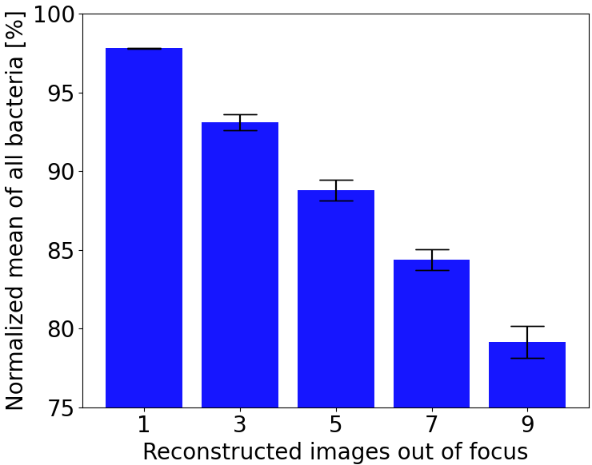
Results: Focusing
Spatial and temporal noise have a zero mean, so they disturb the image and make segmentation harder, but ultimately bacterial mass is not influenced that much.
Where as out of focus images decrease the bacteria’s mass considerably.
The following figure shows how much the mass is decreased with n of 25 images 1cm out of focus.

Slide 15
Previous workflow for segmentation and tracking
Load time-lapse data into Ilastik (interactive learning and segmentation toolkit)
Semi-automatically segment bacteria using Ilastik
Using a python script postprocess segmentation and using another script for tracking.
Problems:
Ilastik does not generalize well, so each experiment has to be segmented by hand.
Workflow takes a lot of time to evaluate results
Dependent on human segmentation → not objective, especially over time

Slide 16
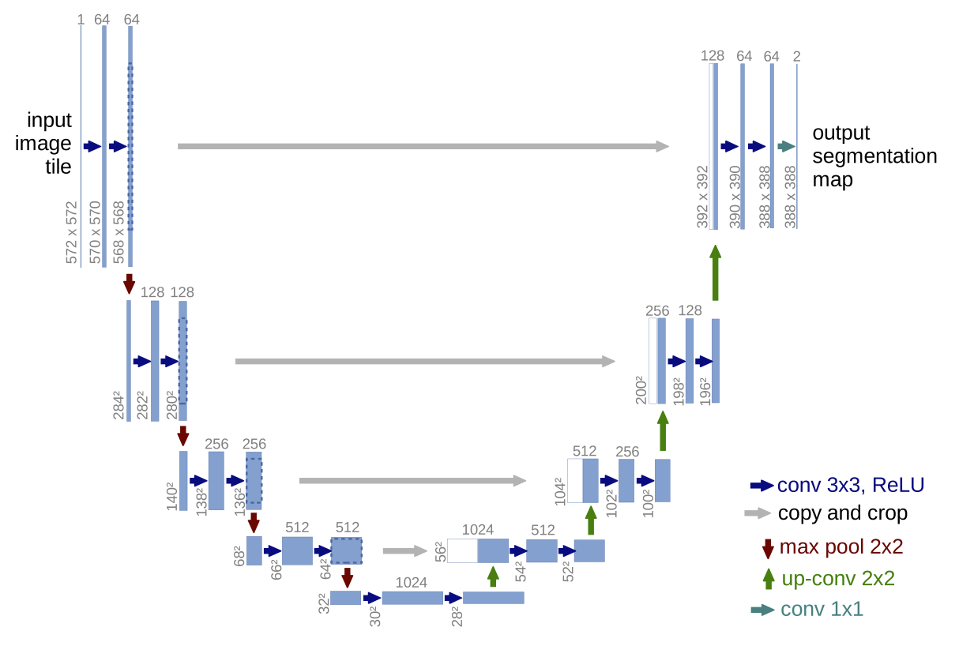
Segmentation and Tracking with U-Net
U-Net has been shown to work well for segmentation
Encoder-decoder structure
Starts with high resolution features, gradually reducing the spacial dimension to capture high-level features.
Skip connections allow features from different scales to interact.
Data augmentation allows the model to gerneralize well even with few data.
Deep Learning for Time-Lapse Analysis (DeLTA) is based on the U-Net and used in this work.

Slide 17
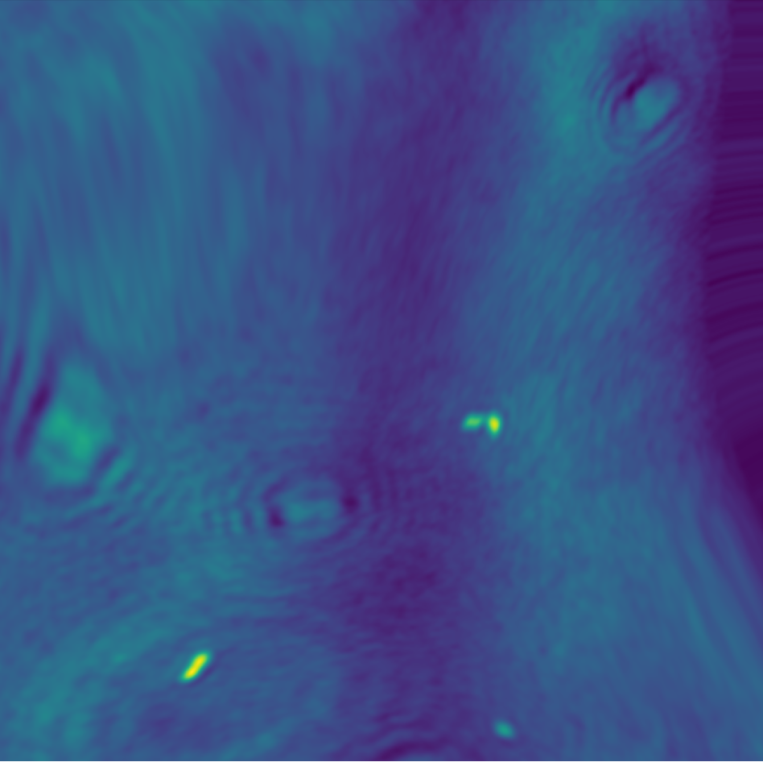
Data augmentation
Data aumentation entails:
Rotation
Vertical flip
Horizontal flip
Illuminatoin
Gaussian noise
Gaussian blur
Elastic deformation

Slide 18
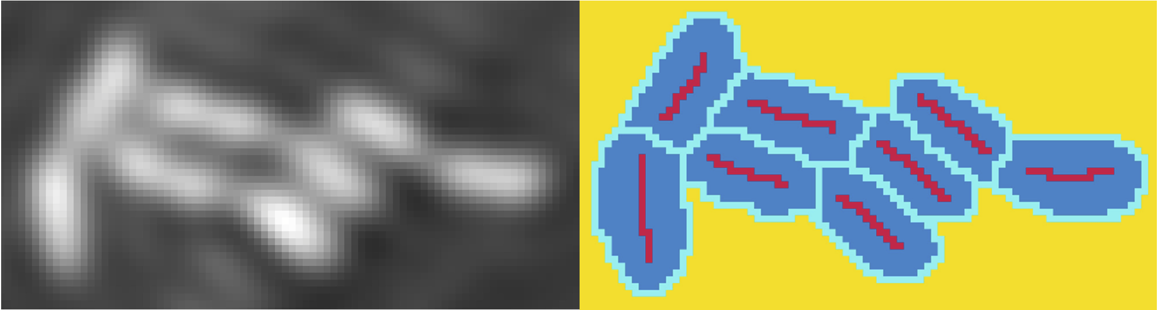
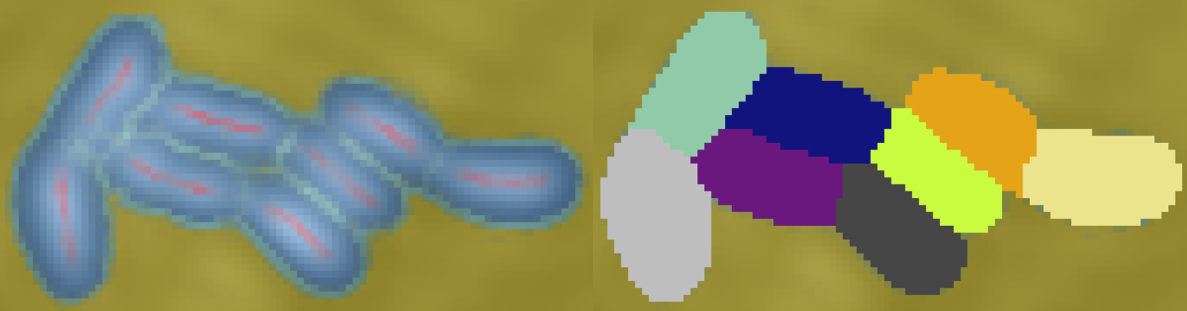
Preparation of training data: Segmentation with Ilastik
Manual pixel categorization
Train ilastik by categorizing pixels into core, bacteria, boundary and background.
Prediction of other pixels based on preselected feature set
Separation between bacteria based on core.
Full size based on the
Ilastik‘s learned segmentation

Slide 19
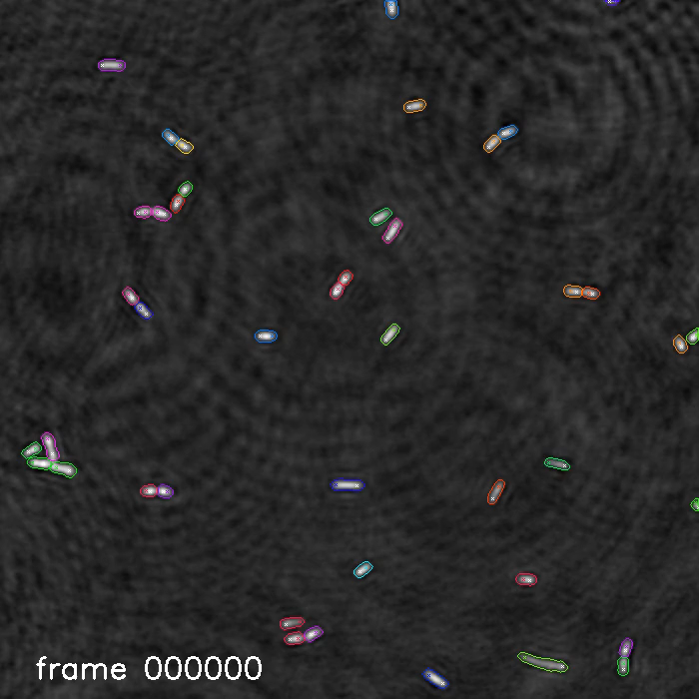
Results: Time-lapse video of bacterial growth and linage

Slide 20
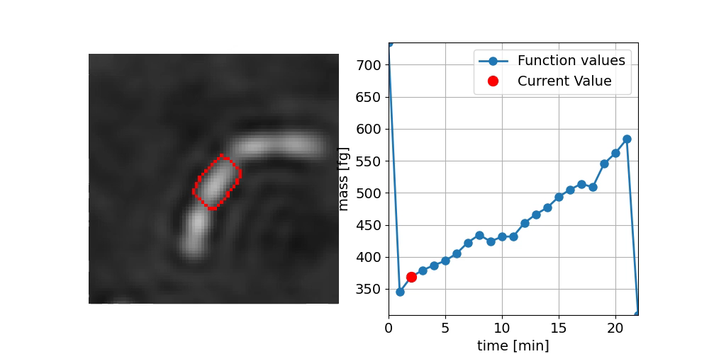
Output linage with features, cell cycles

Slide 21
Summary, pros and cons
Pros:
Decrease in storage space by a factor of 5
Automated focus distance detection
No segmentation training needed for each induvidual experiment
Easily to use and visual output files
Pipeline combines all processes into one easy to use script
Cons:
Processing time is increased (~30h per experiment)
Segmentation accuracy is not improved

Slide 22
Summary and outlook
Automated easy to use pipeline for DHM processing and linage-tracking of time-lapse experiments.
Outlook:
Improve training data generation, by consentrating on a smaller but more precise image batch.
Multimodal approach
Phase contrast image for segmentation, fluorescenece, brightfield
Video

Slide 23
Questions

